Slide 1
A Once in a Half Decade Opportunity
Have your voice heard on the Gifted Operating Standards
Maggie Gunnerson

Slide 2

Who am I?
2e Mom of a 2e family
  Gifted
  Learning Disabled
  ADHD
Serve
  Gifted Advisory Council
  Sycamore Gifted Education Advocates and Resources (GEAR)
  Cincinnati Area Mensa Gifted Youth Leader
  TSSP supporter and alum board member
Undergraduate at Women’s Liberal Arts College, Masters Degree at Purdue
Ex P&G, Ex Chemist
NOT a legal anything

Slide 3

3301-51-15 The Gifted Operating Standard
Notes:
Gets updated at least every 6 years- (two possible extensions which we are in the second- target is 5 years
This is who gets to teach and claim services, what are their workloads and what has to be done.
Must be signed this summer and will be in effect for next fall for the following 5 years

Slide 4
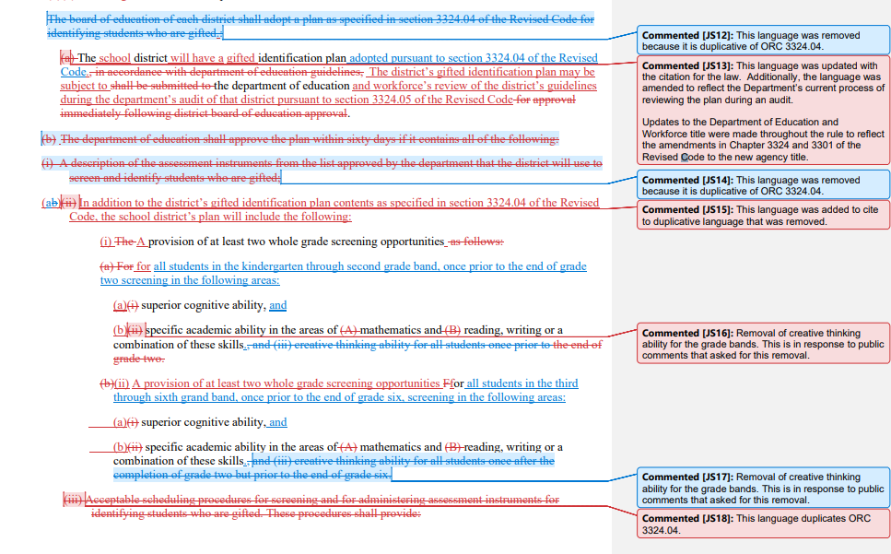
A small section of the draft operating standard, ORC 3301-51-15:
Notes:
This is a bit of a mess- Hard to read- Not terribly precics feels like a cups game…
What I am going to talk to you about first is what is NOT in there…

Slide 5
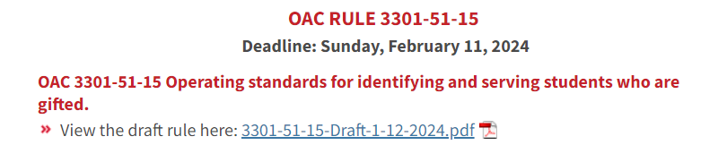
To View Draft Code
Go to: https://education.ohio.gov/About/Ohio-Administrative-Code-OAC-Rule-Comments
Scroll way down to:
https://education.ohio.gov/getattachment/About/Ohio-Administrative-Code-OAC-Rule-Comments/3301-51-15-Draft-1-12-2024.pdf.aspx?lang=en-US is the exact link

Slide 6
Should Ohio Mandate Gifted Services?
National Association of Gifted Children
  Position Statement: Mandated Services for Gifted and Talented Students
  1 page with citations
  Approved 2013
Ohio Association of Gifted Children OAGC “supports and recommends a gifted service mandate” **
29 other states already mandate gifted services***
*https://cdn.ymaws.com/nagc.org/resource/resmgr/knowledge-center/position-statements/Mandated_Services_for_Gifted.pdf
**https://oagc.com/wp-content/uploads/2024/01/1.18.24-Public-Comment-1.pdf
***https://www.hoagiesgifted.org/mandates.htm
Notes:
NAGC- Currently, whether gifted children’s abilities are noticed and developed depends largely on where they live and which school they attend. This reality, which is counter the nation’s equity and achievement goals, leads the National Association for Gifted Children to call for state mandates to identify and serve gifted and talented students and to fund the mandates at appropriate levels.
The Funding thing is critical too--- that needs to be in there. It’s unfair to schools to say you must do all this stuff but not get the resources to do it.

Slide 7
How much expertise/ support for Gifted Services?
Provision of Services
  Gifted Intervention Specialists, GIS, – licensure or endorsement
  General Education Teacher designated as a provider of gifted services (PGS)- additional training and support
GIS limited to 80 gifted students but doesn’t talk about other responsibilities
General education teacher PGS must have regularly scheduled collaborative planning in curriculum development and instruction with an educator who holds licensure or endorsement in gifted education.
That collaborating educator may be a gifted coordinator or other GIS with hundreds of students and regular is a very vague term
Notes:
Gifted coordinators can be the GIS for hundreds of students through General Education teachers– Consider limiting those to 160 or 240 students- 2X or 3X

Slide 8
What has been kept
Once Identified, always Identified
Testing can be administered in a student’s primary language with 504 or IEP accommodations
2 opportunities a year for assessment
Outside testing (other districts or professional) must be accepted
Gifted Coordinators … input from parents of students who are gifted
The different service models- all day, pull out, cluster group, resource room, etc.
Requirements of Gifted Intervention Specialists
General Education Teachers who are designated providers of gifted services areas of competencies and hours to get initial certification

Slide 9
Services
Services include instruction that is differentiated from the standard curriculum for that course in depth, breadth, complexity, pace, and/or where content is above-grade level.
Gifted class must occur during a typical instruction day
Instructional time, class size, and caseload ratios for all service settings will be equivalent to districtwide instruction time, class size, and caseload rations for the corresponding subject grade level and setting with listed exceptions.
Notes:
Mention fully contained, subject pull out, cluster groups

Slide 10
What is gone
No service letter- when students qualify for gifted instruction but are not going to be provided that instruction, currently districts must inform families of that lack of services.
Required screening for creative thinking although you may still request it
Limit to students in self contained gifted classroom or cluster group although classroom must still be equivalent to standard classrooms
Innovative Gifted Service Proposal section

Slide 11
What is new
Minimum cluster group size- 3- may be problematic for small districts or districts with few identified gifted students.
Written Education Plans (WEP) must now have an explanation of how the gifted services meet the student’s documented strengths, educational needs, and goals for the student.
WEP meetings in addition to signatures- good idea? Or just a drain?
Student Talent Development Section- allows for funds but may hurt GISes and students as this could be added to some GIS workload
Gifted Advisory Council (GAC) now consults on a performance indicator
5 Clock hours of ongoing specialized training in gifted education for general education teachers each year (currently determined by the district)

Slide 12

How to learn more and talk to OAGC
To catch up on OAGC, check out their advocacy update at https://oagc.com/advocacy/advocacy-alerts/
People can also talk about their thoughts on the law at OAGC Gifted Rule Draft Meetings
  February 9th 4-5pm
Join Zoom Meeting
  https://us02web.zoom.us/j/84077908974
  Meeting ID: 840 7790 8974

Slide 13
How to comment:
If you support have comments around
Gifted service mandate
Funding for gifted in Ohio
Want to see limits put on how many supporting/talent development roles GIS have (teachers or coordinators)
Cluster groups concerns
Please email rulecomments@education.ohio.gov and say so by Feb. 11th Put in 3301-51-15 in your comment.
Notes:
That is really the big one and needs to happen. Much of the changes are taking out duplicative language. Shall has been turned to will, drawing painting scytping now is simplu visual arts
There is much more and I will hit some of the highlights.

